Slide 1
Cluster Tracker v2
Group 4

Slide 2
Contents
Changes
Project Aim
BOM
Mechanical assembly
Algorithm
Timeline and milestones

Slide 3
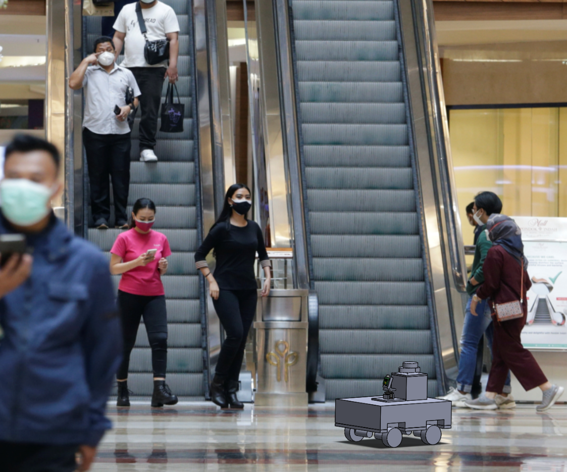
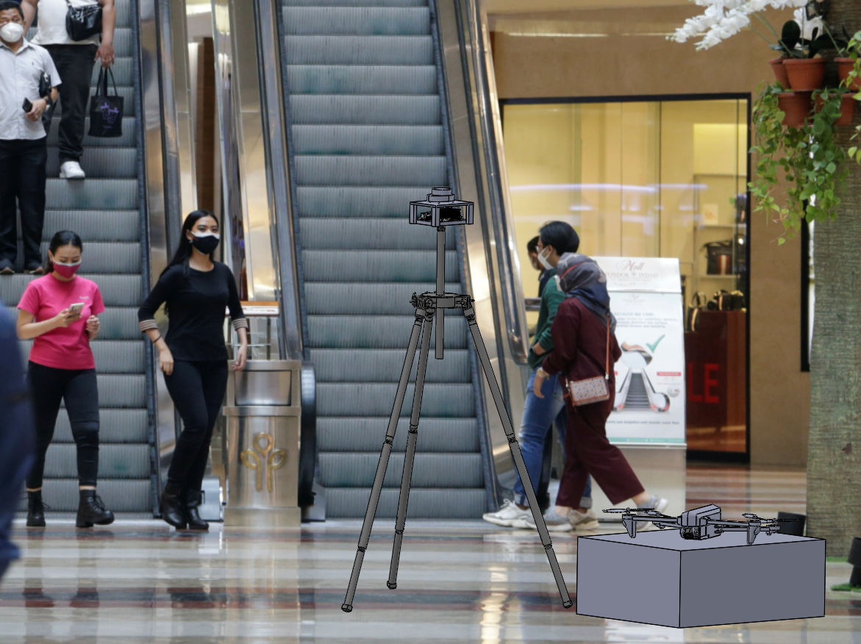
Changes
Previously
Enforce social distancing with an autonomous ground robot via a LiDAR and camera
Now
Stationary LiDAR tracks the clusters of people
Autonomous drone alerts people who breach social distancing

Slide 4
Aim
To create an autonomous system that identifies and tracks clusters of people (size, inter-cluster interaction and distance) using LiDAR and enforce social distancing through an autonomous drone.

Slide 5
BOM
Components | Specifications | Total Price (excluding shipping, SGD) | Quantity
Power Supply | Output voltage: 5V Output current: 4000mA Output power: 20W Max | 13.80 | 1
LiDAR (360º) | Range: 12m Scan rate: 2-10Hz Sample rate: 8000/s Voltage supply: 5V | 138.14 | 1
Drone | Weight: 80g Battery: 1.1Ah/3.8v Flight time: 13 mins max WiFi: 2.4 Ghz Rangefinder | 136.77 | 1

Slide 6
BOM
Components | Specifications | Total Price (excluding shipping, SGD) | Quantity
MicroSD Card | Storage: 64Gb | 3.99 | 1
NVIDIA Jetson Nano Developer Kit | Memory: 2Gb Power supply: 5W | 87 | 1
Casing for Jetson Nano | Material: acrylic Dimensions : 110 x 88 x 42 mm Add-ons: 5V cooling fan Supports 2 WiFi antennas Version: 2GB | 18.90 | 1

Slide 7
BOM
Components | Specifications | Total Price (excluding shipping, SGD) | Quantity
WiFi Card | WiFi: 2.4/5Ghz dual band Speed: 300/867 Mbps Bluetooth: Bluetooth 4.2 | 19.71 | 1
 |  | Total cost (incl shipping): SGD 446.39 The longest estimated lead time: 2 weeks

Slide 8
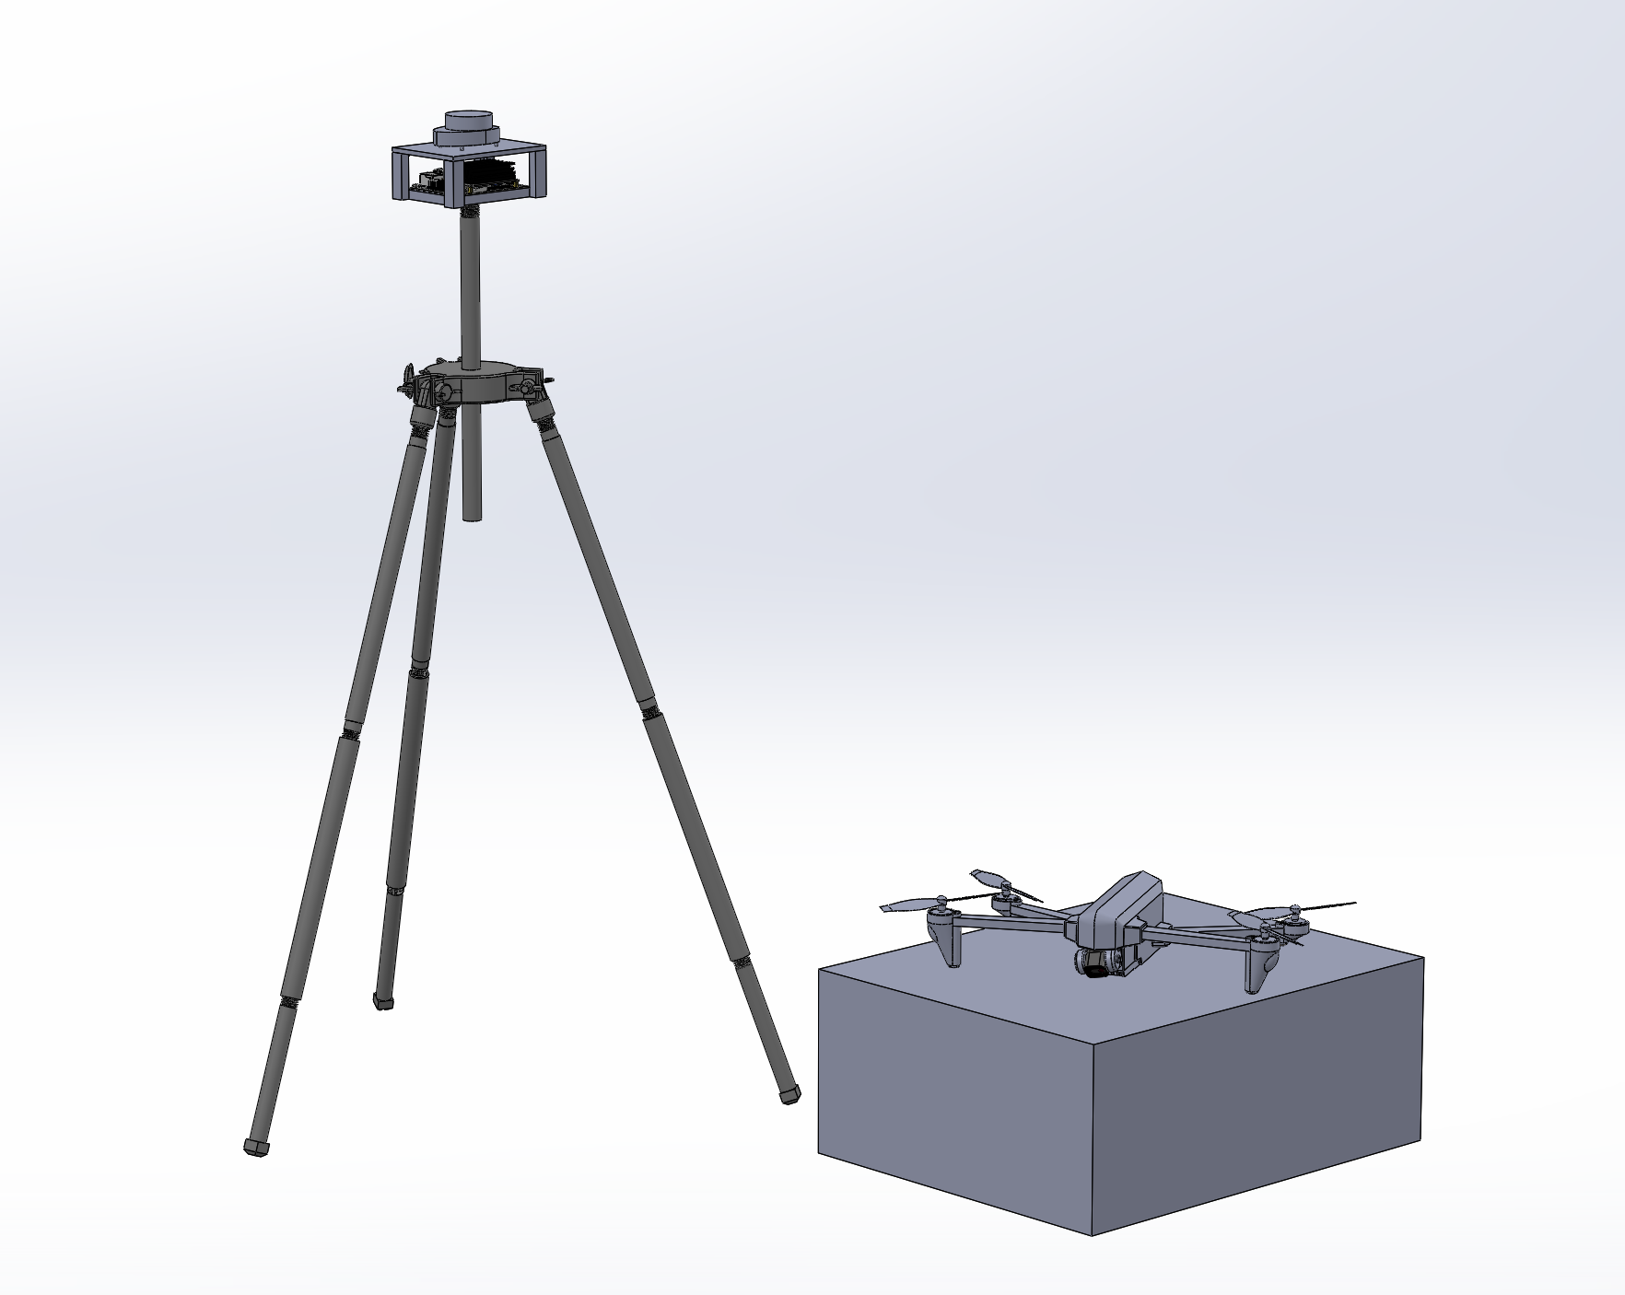
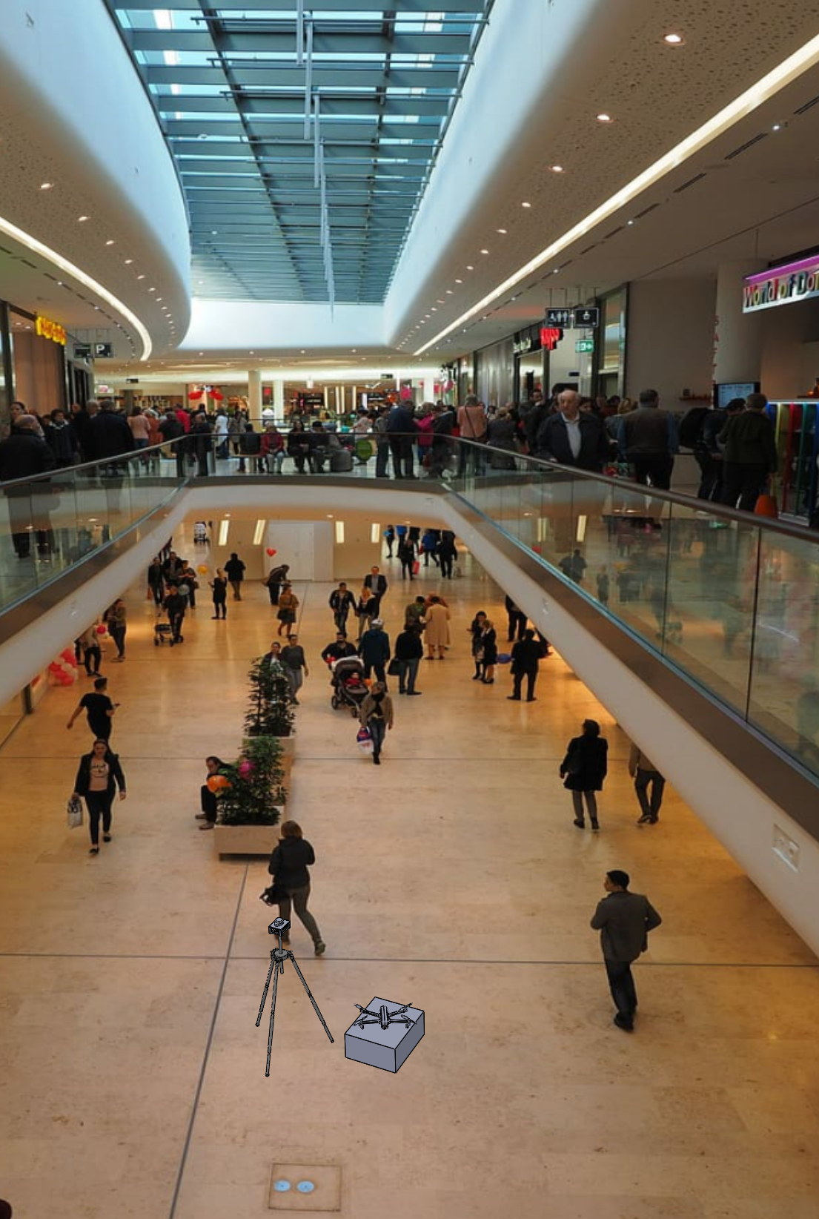
Mechanical Assembly
360° 2D LiDAR
Identifies and tracks clusters of people
Jetson Nano
Processes LiDAR point clouds
DJI Tello
Approaches and alerts rule-breakers

Slide 9
Algorithm
10 seconds timer up
Send drone
Grouping of people into clusters by LiDAR
Tracking of each cluster size, inter-cluster distance and interactions
Rules broken
Starts 10 seconds timer
Rules no longer broken

Slide 10
Models for
Object Recognition
Software
YOLO V3 (point cloud data as people)
Deep Sort (classify into unique people in the cluster)
Jetpack sdk (jetson nano)
ROS

Slide 11
Timeline and milestones
Recess week | Detection of clusters
Week 7 | Detection of exceeding cluster size; interim presentation
Week 8 | Detection of 1m inter-cluster distance breached
Week 9 | Detection of interaction between clusters
Week 10 | Drone flying to the coordinates at a specific height; datasheet, initial demo
Week 11 | Obstacle avoidance, payload delivery
Week 12 | Extra time; project abstract and final datasheet
Week 13 | Final presentation
Notes:
Week 6: receive

Slide 12
Thank You!

